Slide 1

Fourier Series for Odd and Periodic Function
Fourier series for odd and period function
Let’s consider function $f$ which is a odd and periodic function.
$$f\left(−x\right)=−f(x)$$
$$f\left(x+λ\right)=f\left(x\right)$$
Here $λ$is period.
$λ$ is usually called as a wavelength, which is a spatial period of a periodic wave.
Let’s assume that following relation is always true
$$f\left(x\right)=\sum_{m=0}^{∞}{F_{m}\sin{(mk_{0}x)}} where k_{0}=\frac{2π}{λ}$$
Here $F_{m}$ is a Fourier coefficient and $k_{0}$ is called as a wave number or angular wavenumber.
$F_{m}$ can be readily obtained from Eq. (1) with orthogonal property of trigonometric function.
$$\int_{−\frac{λ}{2}}^{\frac{λ}{2}}{f(x)\sin\left(mk_{0}x\right)}dx=F_{m}\int_{−\frac{λ}{2}}^{\frac{λ}{2}}{\sin^{2}\left(mk_{0}x\right)}dx=F_{m}\frac{λ}{2}$$
$$⇒F_{m}=\frac{2}{λ}\int_{−\frac{λ}{2}}^{\frac{λ}{2}}{f(x)\sin\left(mk_{0}x\right)}dx$$
(1)
(2)

Slide 2

Fourier Series for Odd and Periodic Function
Eq. (2) can see as a extract odd function property from original function by eliminate even function property .
For example, Let’s consider arbitrary function $p(x)$
Then $p(x)$ can be decomposed by odd function and even function as follow
$$p\left(x\right)=\frac{p\left(x\right)+p\left(−x\right)}{2}+\frac{p\left(x\right)−p\left(−x\right)}{2}=p_{even}\left(x\right)+p_{odd}(x)$$
Substitute $p\left(x\right)$ into Eq.(2)
$$P_{m}=\frac{2}{λ}\int_{−\frac{λ}{2}}^{\frac{λ}{2}}{\left[p_{even}\left(x\right)+p_{odd}\left(x\right)\right]\sin\left(mk_{0}x\right)}dx$$
Integration odd function over a period always 0
$$P_{m}=\frac{2}{λ}\int_{−\frac{λ}{2}}^{\frac{λ}{2}}{p_{odd}\left(x\right)\sin\left(mk_{0}x\right)}dx=\frac{4}{λ}\int_{0}^{\frac{λ}{2}}{p_{odd}\left(x\right)\sin\left(mk_{0}x\right)}dx$$
The result is only about $p_{odd}\left(x\right)$.
(3)

Slide 3
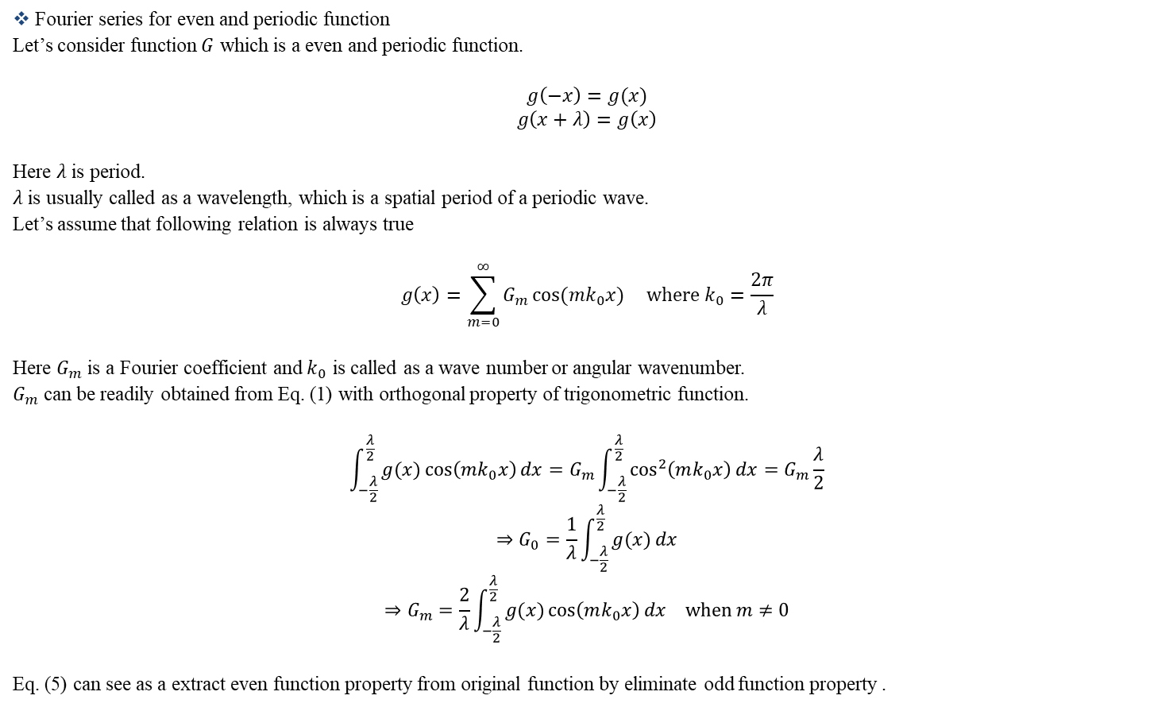
Fourier Series for Even and Periodic Function
Fourier series for even and periodic function
Let’s consider function $G$ which is a even and periodic function.
$$g\left(−x\right)=g(x)$$
$$g\left(x+λ\right)=g\left(x\right)$$
Here $λ$is period.
$λ$ is usually called as a wavelength, which is a spatial period of a periodic wave.
Let’s assume that following relation is always true
$$g\left(x\right)=\sum_{m=0}^{∞}{G_{m}\cos{(mk_{0}x)}} where k_{0}=\frac{2π}{λ}$$
Here $G_{m}$ is a Fourier coefficient and $k_{0}$ is called as a wave number or angular wavenumber.
$G_{m}$ can be readily obtained from Eq. (1) with orthogonal property of trigonometric function.
$$\int_{−\frac{λ}{2}}^{\frac{λ}{2}}{g(x)\cos\left(mk_{0}x\right)}dx=G_{m}\int_{−\frac{λ}{2}}^{\frac{λ}{2}}{\cos^{2}\left(mk_{0}x\right)}dx=G_{m}\frac{λ}{2}$$
$$⇒G_{0}=\frac{1}{λ}\int_{−\frac{λ}{2}}^{\frac{λ}{2}}{g(x)}dx$$
$$⇒G_{m}=\frac{2}{λ}\int_{−\frac{λ}{2}}^{\frac{λ}{2}}{g(x)\cos\left(mk_{0}x\right)}dx when m≠0$$
Eq. (5) can see as a extract even function property from original function by eliminate odd function property .
(4)
(5)

Slide 4
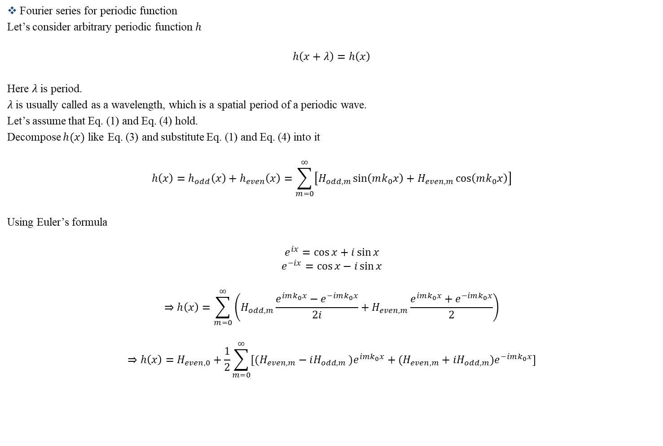
Fourier Series for Periodic Function
Fourier series for periodic function
Let’s consider arbitrary periodic function $h$
$$h\left(x+λ\right)=h\left(x\right)$$
Here $λ$is period.
$λ$ is usually called as a wavelength, which is a spatial period of a periodic wave.
Let’s assume that Eq. (1) and Eq. (4) hold.
Decompose $h(x)$ like Eq. (3) and substitute Eq. (1) and Eq. (4) into it
$$h\left(x\right)=h_{odd}\left(x\right)+h_{even}\left(x\right)=\sum_{m=0}^{∞}{\left[H_{odd,m}\sin\left(mk_{0}x\right)+H_{even,m}\cos\left(mk_{0}x\right)\right]}$$
Using Euler’s formula
$$e^{ix}=\cos{x}+i\sin{x}$$
$$e^{−ix}=\cos{x}−i\sin{x}$$
$$⇒h\left(x\right)=\sum_{m=0}^{∞}{\left(H_{odd,m}\frac{e^{imk_{0}x}−e^{−imk_{0}x}}{2i}+H_{even,m}\frac{e^{imk_{0}x}+e^{−imk_{0}x}}{2}\right)}$$
$$⇒h\left(x\right)=H_{even,0}+\frac{1}{2}\sum_{m=0}^{∞}{[{(H_{even,m}−iH_{odd,m}}_{ })e^{imk_{0}x}+(H_{even,m}+iH_{odd,m})e^{−imk_{0}x}]}$$

Slide 5

Fourier Series for Periodic Function
$$⇒h\left(x\right)=\sum_{m=−∞}^{∞}{H_{m}e^{imk_{0}x}} where H_{m}=\left\{\begin{matrix}h_{even,0} & for m=0 \\ \frac{h_{even,m}−ih_{odd,m}}{2} & for m>0 \\ \frac{h_{even,−m}+ih_{odd,−m}}{2} & for m<0\end{matrix}\right.$$
From Eq. (2)
$$h_{odd,m}=\frac{2}{λ}\int_{−\frac{λ}{2}}^{\frac{λ}{2}}{h_{odd}(x)\sin\left(mk_{0}x\right)}dx=\frac{2}{λ}\int_{−\frac{λ}{2}}^{\frac{λ}{2}}{\left[h_{odd}\left(x\right)+h_{even}\left(x\right)\right]\sin\left(mk_{0}x\right)}dx=\frac{2}{λ}\int_{−\frac{λ}{2}}^{\frac{λ}{2}}{h(x)\sin\left(mk_{0}x\right)}dx$$
In the same way
$$h_{even,0}=\frac{1}{λ}\int_{−\frac{λ}{2}}^{\frac{λ}{2}}{h(x) }dx$$
$$h_{even,m}=\frac{2}{λ}\int_{−\frac{λ}{2}}^{\frac{λ}{2}}{h(x)\cos\left(mk_{0}x\right)}dx where m≠0$$

Slide 6

Fourier Series for Periodic Function
Finally
$$⇒h\left(x\right)=\sum_{m=−∞}^{∞}{H_{m}e^{imk_{0}x}} where H_{m}=\left\{\begin{matrix}\frac{1}{λ}\int_{−\frac{λ}{2}}^{\frac{λ}{2}}{h(x) }dx & for m=0 \\ \frac{1}{λ}\int_{−\frac{λ}{2}}^{\frac{λ}{2}}{h\left(x\right)\left[\cos\left(mk_{0}x\right)−i\sin\left(mk_{0}x\right)\right]}dx⇒\frac{1}{λ}\int_{−\frac{λ}{2}}^{\frac{λ}{2}}{h\left(x\right)e^{−imk_{0}x}}dx & for m>0 \\ \frac{1}{λ}\int_{−\frac{λ}{2}}^{\frac{λ}{2}}{h\left(x\right)\left[\cos\left(−mk_{0}x\right)+i\sin\left(−mk_{0}x\right)\right]}dx⇒\frac{1}{λ}\int_{−\frac{λ}{2}}^{\frac{λ}{2}}{h\left(x\right)e^{−imk_{0}x}}dx & for m<0\end{matrix}\right.$$
Simplify using Euler’s formula
$$h\left(x\right)=\sum_{m=−∞}^{∞}{H_{m}e^{imk_{0}x}} where H_{m}=\frac{1}{λ}\int_{−\frac{λ}{2}}^{\frac{λ}{2}}{h\left(x\right)e^{−imk_{0}x}}dx$$
Or simply assume that every periodic function can be expressed
$$h\left(x\right)=\sum_{m=−∞}^{∞}{H_{m}e^{imk_{0}x}}$$
And derive coefficients using orthogonal property of exponential functions
$$where H_{m}=\frac{1}{λ}\int_{−\frac{λ}{2}}^{\frac{λ}{2}}{h\left(x\right)e^{−imk_{0}x}}dx$$

Slide 7

Convergence of Fourier Series Coefficient
To define Fourier series, we need finite coefficient.
For this, we need to check convergence property of coefficient.
[Proof]
We consider a integral inequality as follow
$$\frac{1}{λ}\int_{−\frac{λ}{2}}^{\frac{λ}{2}}{{\left|h\left(x\right)−\sum_{m=−M}^{M}{H_{m}e^{imk_{0}x}}\right|}^{2}}dx≥0$$
Decompose integrand
$$⇒{\left|h\left(x\right)−\sum_{m=−M}^{M}{H_{m}e^{imk_{0}x}}\right|}^{2}=\left[h\left(x\right)−\sum_{m=−M}^{M}{H_{m}e^{imk_{0}x}}\right]{\left[h\left(x\right)−\sum_{m=−M}^{M}{H_{m}e^{imk_{0}x}}\right]}^{∗}$$
$$={\left|h\left(x\right)\right|}^{2}−h\left(x\right)\sum_{m=−M}^{M}{H_{m}^{∗}e^{−imk_{0}x}}−h^{∗}\left(x\right)\sum_{m=−M}^{M}{H_{m}e^{imk_{0}x}}+\left(\sum_{m=−M}^{M}{H_{m}e^{imk_{0}x}}\sum_{m=−M}^{M}{H_{m}^{∗}e^{−imk_{0}x}}\right)$$
Take integration term by term
$$⇒\frac{1}{λ}\int_{−\frac{λ}{2}}^{\frac{λ}{2}}{{\left|h\left(x\right)\right|}^{2}}dx$$

Slide 8
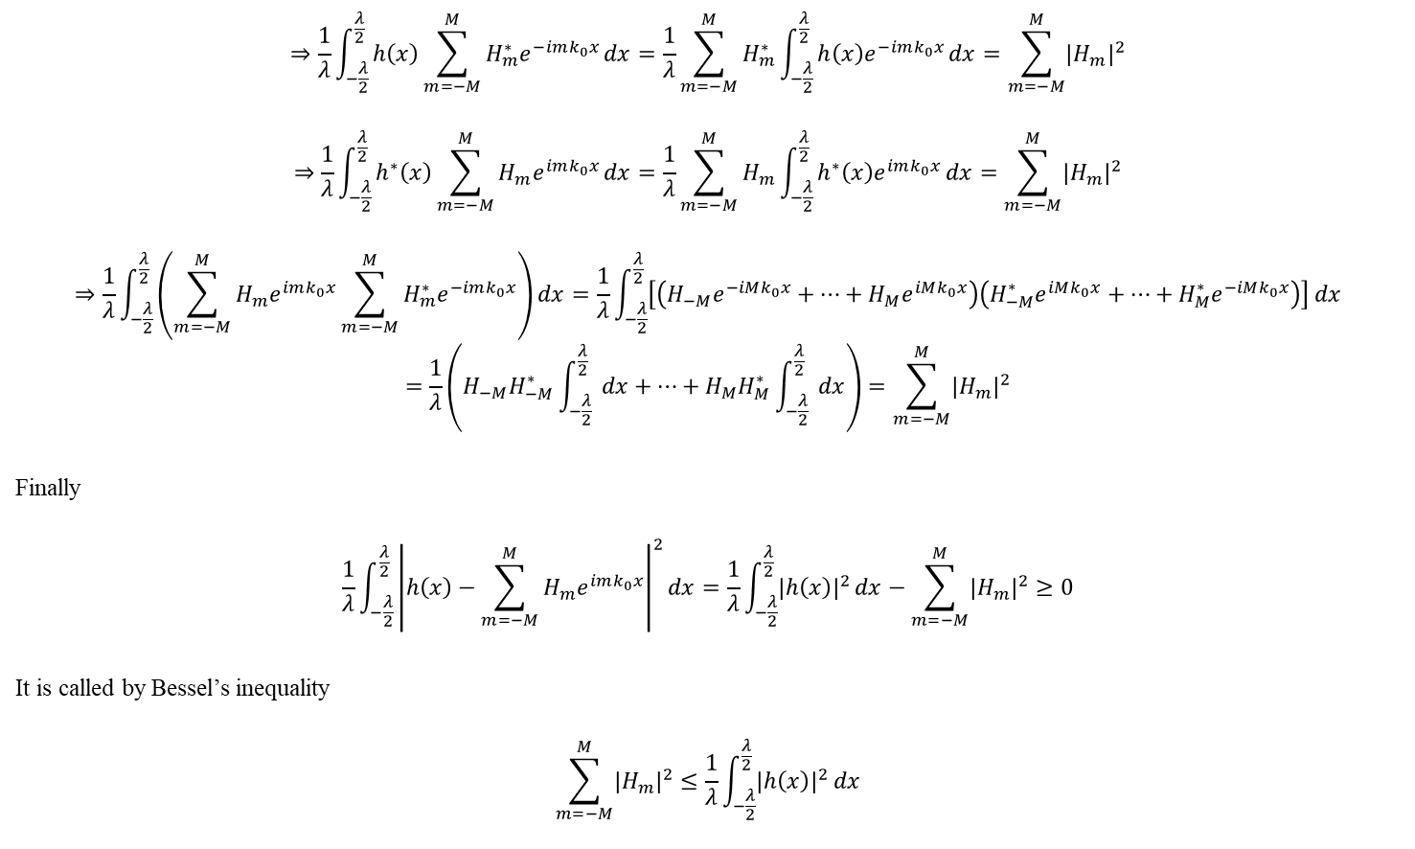
Convergence of Fourier Series Coefficient
$$⇒\frac{1}{λ}\int_{−\frac{λ}{2}}^{\frac{λ}{2}}{h\left(x\right)\sum_{m=−M}^{M}{H_{m}^{∗}e^{−imk_{0}x}}}dx=\frac{1}{λ}\sum_{m=−M}^{M}{H_{m}^{∗}}\int_{−\frac{λ}{2}}^{\frac{λ}{2}}{h\left(x\right)e^{−imk_{0}x}}dx=\sum_{m=−M}^{M}{{\left|H_{m}\right|}^{2}}$$
$$⇒\frac{1}{λ}\int_{−\frac{λ}{2}}^{\frac{λ}{2}}{h^{∗}\left(x\right)\sum_{m=−M}^{M}{H_{m}e^{imk_{0}x}}}dx=\frac{1}{λ}\sum_{m=−M}^{M}{H_{m}}\int_{−\frac{λ}{2}}^{\frac{λ}{2}}{h^{∗}\left(x\right)e^{imk_{0}x}}dx=\sum_{m=−M}^{M}{{\left|H_{m}\right|}^{2}}$$
$$⇒\frac{1}{λ}\int_{−\frac{λ}{2}}^{\frac{λ}{2}}{\left(\sum_{m=−M}^{M}{H_{m}e^{imk_{0}x}}\sum_{m=−M}^{M}{H_{m}^{∗}e^{−imk_{0}x}}\right)}dx=\frac{1}{λ}\int_{−\frac{λ}{2}}^{\frac{λ}{2}}{\left[\left(H_{−M}e^{−iMk_{0}x}+…+H_{M}e^{iMk_{0}x}\right)\left(H_{−M}^{∗}e^{iMk_{0}x}+…+H_{M}^{∗}e^{−iMk_{0}x}\right)\right]}dx$$
$$=\frac{1}{λ}\left(H_{−M}H_{−M}^{∗}\int_{−\frac{λ}{2}}^{\frac{λ}{2}}{ dx}+…+H_{M}H_{M}^{∗}\int_{−\frac{λ}{2}}^{\frac{λ}{2}}{ dx}\right)=\sum_{m=−M}^{M}{{\left|H_{m}\right|}^{2}}$$
Finally
$$\frac{1}{λ}\int_{−\frac{λ}{2}}^{\frac{λ}{2}}{{\left|h\left(x\right)−\sum_{m=−M}^{M}{H_{m}e^{imk_{0}x}}\right|}^{2}}dx=\frac{1}{λ}\int_{−\frac{λ}{2}}^{\frac{λ}{2}}{{\left|h\left(x\right)\right|}^{2}}dx−\sum_{m=−M}^{M}{{\left|H_{m}\right|}^{2}}≥0$$
It is called by Bessel’s inequality
$$\sum_{m=−M}^{M}{{\left|H_{m}\right|}^{2}}≤\frac{1}{λ}\int_{−\frac{λ}{2}}^{\frac{λ}{2}}{{\left|h\left(x\right)\right|}^{2}}dx$$

Slide 9

Convergence of Fourier Series Coefficient
If $h(x)$ is a square-integrable function and integer $M$ can be a infinitely large number, Bessel’s inequality guarantee that infinite series of Fourier series coefficient square is bounded.
It means that if $h(x)$ is a square-integrable function, every component of Fourier series coefficient converge to finite value. $∎$

Slide 10

Convergence of Fourier Series
We consider a continuous and periodic function $f(x)$.
$$f\left(x+λ\right)=f\left(x\right)$$
Then following relation is always true
$$f\left(x\right)=\sum_{m=−∞}^{∞}{F_{m}e^{imk_{0}x}} where F_{m}=\frac{1}{λ}\int_{−\frac{λ}{2}}^{\frac{λ}{2}}{f\left(x\right)e^{−imk_{0}x}}dx ,k_{0}=\frac{2π}{λ}$$
[Proof]
For the proof, we slightly change the form of the Eq. (6) with partial sum $S_{M}(x)$
$$f\left(x\right)=\sum_{m=−∞}^{∞}{F_{m}e^{imk_{0}x}}=\lim_{M→∞}{\sum_{m=−M}^{M}{F_{m}e^{imk_{0}x}}}=\lim_{M→∞}{S_{M}\left(x\right)}$$
$$S_{M}\left(x\right)≡\sum_{m=−M}^{M}{F_{m}e^{imk_{0}x}}$$
(6)

Slide 11
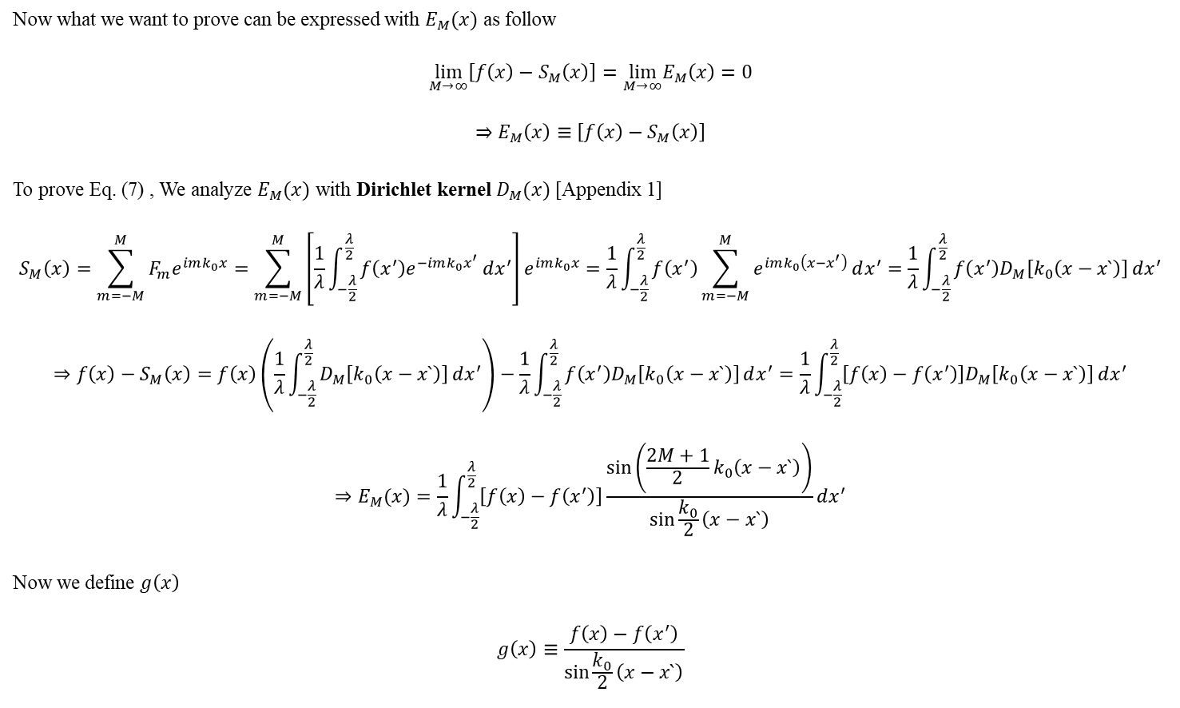
Convergence of Fourier Series
Now what we want to prove can be expressed with $E_{M}(x)$ as follow
$$\lim_{M→∞}\left[f\left(x\right)−S_{M}\left(x\right)\right]=\lim_{M→∞}E_{M}\left(x\right)=0$$
$$⇒E_{M}\left(x\right)≡\left[f\left(x\right)−S_{M}\left(x\right)\right]$$
To prove Eq. (7) , We analyze $E_{M}(x)$ with Dirichlet kernel $D_{M}(x)$ [Appendix 1]
$$S_{M}\left(x\right)=\sum_{m=−M}^{M}{F_{m}e^{imk_{0}x}}=\sum_{m=−M}^{M}{\left[\frac{1}{λ}\int_{−\frac{λ}{2}}^{\frac{λ}{2}}{f\left(x^{′}\right)e^{−imk_{0}x^{′}}}dx^{′}\right]e^{imk_{0}x}}=\frac{1}{λ}\int_{−\frac{λ}{2}}^{\frac{λ}{2}}{f\left(x^{′}\right)\sum_{m=−M}^{M}{e^{imk_{0}\left(x−x^{′}\right)}}}dx^{′}=\frac{1}{λ}\int_{−\frac{λ}{2}}^{\frac{λ}{2}}{f\left(x^{′}\right)D_{M}\left[k_{0}\left(x−x`\right)\right]}dx^{′}$$
$$⇒f\left(x\right)−S_{M}\left(x\right)=f\left(x\right)\left(\frac{1}{λ}\int_{−\frac{λ}{2}}^{\frac{λ}{2}}{D_{M}\left[k_{0}\left(x−x`\right)\right]}dx^{′}\right)−\frac{1}{λ}\int_{−\frac{λ}{2}}^{\frac{λ}{2}}{f\left(x^{′}\right)D_{M}\left[k_{0}\left(x−x`\right)\right]}dx^{′}=\frac{1}{λ}\int_{−\frac{λ}{2}}^{\frac{λ}{2}}{\left[f\left(x\right)−f\left(x^{′}\right)\right]D_{M}\left[k_{0}\left(x−x`\right)\right]}dx^{′}$$
$$⇒E_{M}(x)=\frac{1}{λ}\int_{−\frac{λ}{2}}^{\frac{λ}{2}}{\left[f\left(x\right)−f\left(x^{′}\right)\right]\frac{\sin\left(\frac{2M+1}{2}k_{0}\left(x−x`\right)\right)}{\sin{\frac{k_{0}}{2}\left(x−x`\right)}}}dx^{′}$$
Now we define $g\left(x\right)$
$$g\left(x\right)≡\frac{f\left(x\right)−f\left(x^{′}\right)}{\sin{\frac{k_{0}}{2}\left(x−x`\right)}}$$
(7)

Slide 12

Convergence of Fourier Series
When $f(x)$ is continuous function, $g(x)$ is also continuous function except at $x=x′$.
Let’s think about $g(x)$ at $x=x′$ through L'Hôpital's rule
$$g\left(x′\right)=\lim_{x→x`}{g(x)}=\frac{2}{k_{0}}f′(x^{′})$$
We assume that for a continuous function $f(x)$, differential coefficient of $f$ is finite except for finite points.
Then $g(x^{′})$ has a finite value.
Therefore $g(x)$ is a Riemann-integrable function.
Rewrite $E_{M}$ with $g(x)$
$$E_{M}=\frac{1}{λ}\int_{−\frac{λ}{2}}^{\frac{λ}{2}}{g(x)\sin\left(\frac{2M+1}{2}k_{0}\left(x−x`\right)\right)}dx^{′}$$
By Riemann-Lebesgue lemma [Appendix 2]
$$\lim_{M→∞}{E_{M}}=0 ∎$$

Slide 13

Convergence of Fourier Series
[Proof 2]
First, We will show that Fourier series is a solution of Strum-Liouville differential equation.
If we put $p\left(x\right)=1, q\left(x\right)=0, r\left(x\right)=1, λ=m^{2}$ into Strum-Liouville differential equation
$$\frac{d}{dx}\left(p\left(x\right)\frac{dy}{dx}\right)+λr\left(x\right)y−q(x)y=0$$
$$⇒\frac{d^{2}y}{dx^{2}}+m^{2}y=0$$
$$⇒y=ce^{imx}$$
It is shows that linear combination of complex exponential function satisfy Strum-Liouville differential equation.
And boundary condition is fix because it’s periodic.
Therefore complex exponential function is a eigenfunction.
According to the completeness of eigenfunction, every square-integrable $f$ can be expressed by Fourier series. $∎$

Slide 14

Convergence of Fourier Series for Piecewise Continuous Function
We consider a piecewise continuous and periodic function $f(x)$.
$$f\left(x+λ\right)=f\left(x\right)$$
Then following relation is always true
$$\frac{f\left(x_{+}\right)+f\left(x_{−}\right)}{2}=\sum_{m=−∞}^{∞}{F_{m}e^{imk_{0}x}}$$
$$f\left(x_{+}\right)≡\lim_{h→0}{f\left(t+h\right)} for h>0$$
$$f\left(x_{−}\right)≡\lim_{h→0}{f\left(t−h\right)} for h>0$$
$$F_{m}≡\frac{1}{λ}\int_{−\frac{λ}{2}}^{\frac{λ}{2}}{f\left(x\right)e^{−imk_{0}x}}dx ,k_{0}≡\frac{2π}{λ}$$
[Proof]
For the proof, we slightly change the form of the Eq. (8) with partial sum $S_{M}(x)$
$$\frac{f\left(x_{+}\right)+f\left(x_{−}\right)}{2}=\sum_{m=−∞}^{∞}{F_{m}e^{imk_{0}x}}=\lim_{M→∞}{\sum_{m=−M}^{M}{F_{m}e^{imk_{0}x}}}=\lim_{M→∞}{S_{M}\left(x\right)}$$
$$S_{M}\left(x\right)≡\sum_{m=−M}^{M}{F_{m}e^{imk_{0}x}}$$
(8)

Slide 15

Convergence of Fourier Series for Piecewise Continuous Function
Now what we want to prove can be expressed with $E_{M}(x)$ as follow
$$\lim_{M→∞}\left[\frac{f\left(x_{+}\right)+f\left(x_{−}\right)}{2}−S_{M}\left(x\right)\right]=\lim_{M→∞}E_{M}\left(x\right)=0$$
$$⇒E_{M}\left(x\right)≡\left[\frac{f\left(x_{+}\right)+f\left(x_{−}\right)}{2}−S_{M}\left(x\right)\right]$$
To prove Eq. (7) , We analyze $E_{M}(x)$ with Dirichlet kernel $D_{M}(x)$ [Appendix 1]
$$S_{M}\left(x\right)=\sum_{m=−M}^{M}{F_{m}e^{imk_{0}x}}=\sum_{m=−M}^{M}{\left[\frac{1}{λ}\int_{−\frac{λ}{2}}^{\frac{λ}{2}}{f\left(x^{′}\right)e^{−imk_{0}x^{′}}}dx^{′}\right]e^{imk_{0}x}}=\frac{1}{λ}\int_{−\frac{λ}{2}}^{\frac{λ}{2}}{f\left(x^{′}\right)\sum_{m=−M}^{M}{e^{imk_{0}\left(x−x^{′}\right)}}}dx^{′}=\frac{1}{λ}\int_{−\frac{λ}{2}}^{\frac{λ}{2}}{f\left(x^{′}\right)D_{M}[k_{0}\left(x−x^{′}\right)]}dx^{′}$$
Let’s do variable substitution
$$x^{′}=x+x′⇒S_{M}\left(x\right)=\frac{1}{λ}\int_{−\frac{λ}{2}}^{\frac{λ}{2}}{f\left(x^{′}\right)D_{M}[k_{0}\left(x−x^{′}\right)]}dx^{′}=\frac{1}{λ}\int_{x−\frac{λ}{2}}^{x+\frac{λ}{2}}{f\left({x+x}^{′}\right)D_{M}(−k_{0}x^{′})}dx^{′}$$
$$x^{′}=x−x′⇒S_{M}\left(x\right)=\frac{1}{λ}\int_{−\frac{λ}{2}}^{\frac{λ}{2}}{f\left(x^{′}\right)D_{M}[k_{0}\left(x−x^{′}\right)]}dx^{′}=−\frac{1}{λ}\int_{x+\frac{λ}{2}}^{x−\frac{λ}{2}}{f\left({x−x}^{′}\right)D_{M}(k_{0}x^{′})}dx^{′}$$
(9)

Slide 16
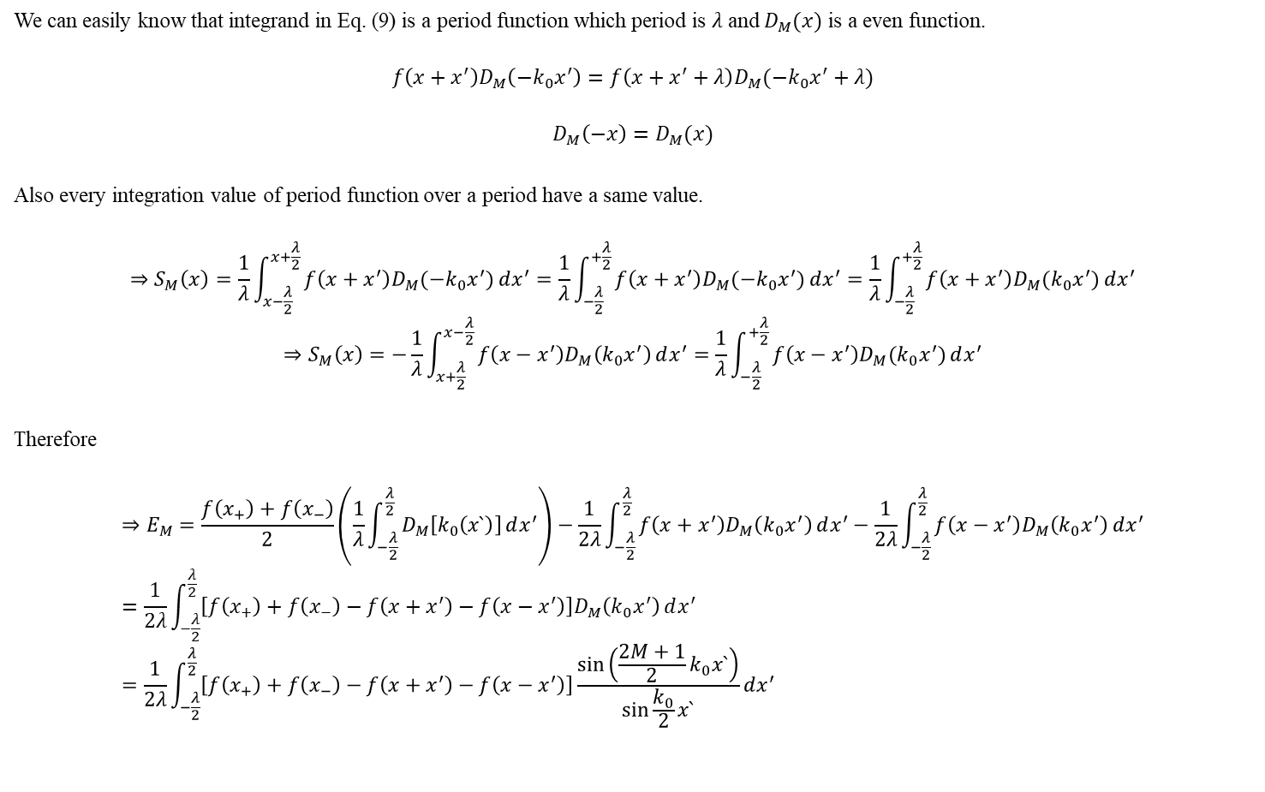
Convergence of Fourier Series for Piecewise Continuous Function
We can easily know that integrand in Eq. (9) is a period function which period is $λ$ and $D_{M}(x)$ is a even function.
$$f\left({x+x}^{′}\right)D_{M}\left(−k_{0}x^{′}\right)=f\left({x+x}^{′}+λ\right)D_{M}(−k_{0}x^{′}+λ)$$
$$D_{M}\left(−x\right)=D_{M}(x)$$
Also every integration value of period function over a period have a same value.
$$⇒S_{M}\left(x\right)=\frac{1}{λ}\int_{x−\frac{λ}{2}}^{x+\frac{λ}{2}}{f\left({x+x}^{′}\right)D_{M}(−k_{0}x^{′})}dx^{′}=\frac{1}{λ}\int_{−\frac{λ}{2}}^{+\frac{λ}{2}}{f\left({x+x}^{′}\right)D_{M}(−k_{0}x^{′})}dx^{′}=\frac{1}{λ}\int_{−\frac{λ}{2}}^{+\frac{λ}{2}}{f\left({x+x}^{′}\right)D_{M}(k_{0}x^{′})}dx^{′}$$
$$⇒S_{M}\left(x\right)=−\frac{1}{λ}\int_{x+\frac{λ}{2}}^{x−\frac{λ}{2}}{f\left({x−x}^{′}\right)D_{M}\left(k_{0}x^{′}\right)}dx^{′}=\frac{1}{λ}\int_{−\frac{λ}{2}}^{+\frac{λ}{2}}{f\left({x−x}^{′}\right)D_{M}(k_{0}x^{′})}dx^{′}$$
Therefore
$$⇒E_{M}=\frac{f\left(x_{+}\right)+f\left(x_{−}\right)}{2}\left(\frac{1}{λ}\int_{−\frac{λ}{2}}^{\frac{λ}{2}}{D_{M}\left[k_{0}\left(x`\right)\right]}dx^{′}\right)−\frac{1}{2λ}\int_{−\frac{λ}{2}}^{\frac{λ}{2}}{f\left(x+x^{′}\right)D_{M}\left(k_{0}x^{′}\right)}dx^{′}−\frac{1}{2λ}\int_{−\frac{λ}{2}}^{\frac{λ}{2}}{f\left(x−x^{′}\right)D_{M}\left(k_{0}x^{′}\right)}dx^{′}=\frac{1}{2λ}\int_{−\frac{λ}{2}}^{\frac{λ}{2}}{\left[f\left(x_{+}\right)+f\left(x_{−}\right)−f\left(x+x^{′}\right)−f\left(x−x^{′}\right)\right]D_{M}\left(k_{0}x^{′}\right)}dx^{′} =\frac{1}{2λ}\int_{−\frac{λ}{2}}^{\frac{λ}{2}}{\left[f\left(x_{+}\right)+f\left(x_{−}\right)−f\left(x+x^{′}\right)−f\left(x−x^{′}\right)\right]\frac{\sin\left(\frac{2M+1}{2}k_{0}x`\right)}{\sin{\frac{k_{0}}{2}x`}}}dx^{′}$$

Slide 17

Convergence of Fourier Series for Piecewise Continuous Function
Let’s define $g(x)$
$$g\left(x\right)≡\frac{f\left(x_{+}\right)+f\left(x_{−}\right)−f\left(x+x^{′}\right)−f\left(x−x^{′}\right)}{\sin{\frac{k_{0}}{2}x`}}$$
Since $g\left(x\right)$ have a finite value except for the $x^{′}→0$, we have to clarify the value of $g\left(x\right)$ when $x^{′}→0$.
First, we decompose $g(x)$ as follow
$$g\left(x\right)=\frac{f\left(x_{+}\right)−f\left(x+x^{′}\right)}{\sin{\frac{k_{0}}{2}x`}}+\frac{f\left(x_{−}\right)−f\left(x−x^{′}\right)}{\sin{\frac{k_{0}}{2}x`}}$$
Then we can see $g(x)$ when $x^{′}→0^{+}$, By L'Hôpital's rule with variable $x′$
$$\lim_{x^{′}→0^{+}}{g(x)}=−\frac{2}{k_{0}}f^{′}\left(x_{+}\right)+\frac{2}{k_{0}}f′(x_{−})$$
And if we slightly change the expression
$$g\left(x\right)=\frac{f\left(x_{+}\right)−f\left(x−x^{′}\right)}{\sin{\frac{k_{0}}{2}x`}}+\frac{f\left(x_{−}\right)−f\left(x+x^{′}\right)}{\sin{\frac{k_{0}}{2}x`}}$$
Then we can see $g(x)$ when $x^{′}→0^{−}$, By L'Hôpital's rule with variable $x′$
$$\lim_{x^{′}→0^{−}}{g(x)}=\frac{2}{k_{0}}f^{′}\left(x_{+}\right)−\frac{2}{k_{0}}f′(x_{−})$$

Slide 18

Convergence of Fourier Series for Piecewise Continuous Function
So if we assume that $f′(x)$ has a finite value, we can say $g(x)$ has a finite value through entire domain.
Therefore we can say $g(x)$ is Riemann-integrable function.
Rewrite $E_{M}$ with $g(x)$
$$E_{M}=\frac{1}{λ}\int_{−\frac{λ}{2}}^{\frac{λ}{2}}{g(x)\sin\left(\frac{2M+1}{2}k_{0}x`\right)}dx^{′}$$
By Riemann-Lebesgue lemma
$$\lim_{M→∞}{E_{M}}=0 ∎$$

Slide 19

Parseval’s Theorem
For piecewise continuous, periodic and square-integrable function $f\left(x\right)$, limitation of Bessel’s inequality become Parseval’s Theorem.
$$\frac{1}{λ}\int_{−\frac{λ}{2}}^{\frac{λ}{2}}{{\left|f\left(x\right)\right|}^{2}}dx=\sum_{m=−∞}^{∞}{{\left|F_{m}\right|}^{2}}$$
By convergence of Fourier series, integral inequality what we use to derive Bessel’s inequality becomes integral equation
$$\frac{1}{λ}\int_{−\frac{λ}{2}}^{\frac{λ}{2}}{{\left|f\left(x\right)−\sum_{m=−M}^{M}{F_{m}e^{imk_{0}x}}\right|}^{2}}dx≥0$$
$$⇒\lim_{M→∞}{\frac{1}{λ}\int_{−\frac{λ}{2}}^{\frac{λ}{2}}{{\left|f\left(x\right)−\sum_{m=−M}^{M}{F_{m}e^{imk_{0}x}}\right|}^{2}}dx }=0$$

Slide 20
Dirichlet Kernel and Dirac delta function
By completeness of

Slide 21

Appendix 1 Dirichlet Kernel
We define Dirichlet kernel as follow
$$D_{M}\left(x\right)=\sum_{m=−M}^{M}{e^{imx}}$$
Using Euler’s formula we can find different form of Dirichlet kernel
$$D_{M}\left(x\right)=\sum_{m=−M}^{M}{e^{imx}}=\left(e^{−iMx}+e^{iMx}\right)+…\left(e^{−ix}+e^{ix}\right)+1=2\cos\left(Mx\right)+…+2\cos\left(x\right)+1=1+2\sum_{m=1}^{M}{cos⁡(mx)}$$
Let’s calculate Dirichlet kernel.
If we use first form with Euler’s formula and geometric series formula
$$D_{M}\left(x\right)=\sum_{m=−M}^{M}{e^{imx}}=e^{−iMx}\frac{\left(1−{\left(e^{ix}\right)}^{2M+1}\right)}{1−e^{ix}}=e^{−iMx}\frac{\left(e^{−i(\frac{2M+1}{2})x}−e^{i(\frac{2M+1}{2})x}\right)e^{i(\frac{2M+1}{2})x}}{\left(e^{−\frac{ix}{2}}−e^{\frac{ix}{2}}\right)e^{\frac{ix}{2}}}=\frac{\sin\left(\frac{2M+1}{2}x\right)}{\sin{\frac{x}{2}}}$$
And if we use second form with trigonometric identity
$$\cos{a}\sin{b}=\frac{\sin\left(a+b\right)−\sin\left(a−b\right)}{2}$$

Slide 22

Appendix 1 Dirichlet Kernel
$$D_{M}\left(x\right)=1+2\sum_{m=1}^{M}{cos⁡(mx)}$$
$$⇒D_{M}\left(x\right)\sin{\frac{x}{2}}=\sin{\frac{x}{2}}+2\cos{x}\sin{\frac{x}{2}}+…+2\cos{(Mx)}\sin{\frac{x}{2}}$$
$$⇒D_{M}\left(x\right)\sin{\frac{x}{2}}=\sin{\frac{x}{2}}+\left(\sin{\frac{3x}{2}}−\sin{\frac{x}{2}}\right)+…+\left[\sin\left(\frac{2M+1}{2}x\right)−\sin\left(\frac{2M−1}{2}x\right)\right]=\sin\left(\frac{2M+1}{2}x\right)$$
$$⇒D_{M}\left(x\right)=\frac{\sin\left(\frac{2M+1}{2}x\right)}{\sin{\frac{x}{2}}}$$
Next, we consider about integration of $D_{M}$ over $[−π,π]$
$$\int_{−π}^{π}{D_{M}(x)}dx=\int_{−π}^{π}{\left(1+2\sum_{m=1}^{M}{cos⁡(mx)}\right)}dx=2π$$
By it’s definition $D_{M}(x)$ is even function
$$D_{M}\left(x\right)=D_{M}\left(−x\right)$$

Slide 23

Appendix 2 Riemann-Lebesgue Lemma
Riemann-Lebesgue Lemma : sine function
If a function $f(x)$ is a Riemann-integrable function, following equation is always true.
$$\lim_{m→∞}{\int_{a}^{b}{f\left(x\right)\sin{(mx)}}dx}=0$$
[Proof]
Let’s define a set ${\left\{x_{n}\right\}}_{n=0,…,N}$ where $x_{0}=a$ and $x_{N}=b$
Then
$$\int_{a}^{b}{f\left(x\right)\sin{(mx)}}dx=\sum_{n=0}^{N−1}{\int_{x_{n}}^{x_{n+1}}{f\left(t_{n}\right)\sin{(mt_{n})}}dt_{n}}=\lim_{N→∞}{\sum_{n=0}^{N−1}{\int_{x_{n}}^{x_{n+1}}{f\left(t_{n}\right)\sin{(mt_{n})}}dt_{n}}}$$
So, what we want to proof is
$$\lim_{m→∞}{\lim_{N→∞}{\sum_{n=0}^{N−1}{\int_{x_{n}}^{x_{n+1}}{f\left(t_{n}\right)\sin{(mt_{n})}}dt_{n}}}}=0$$
Next, we can define a constant function $g(t_{n})$ which have a infimum of $f(t_{n})$ in the $\left[x_{n},x_{n+1}\right]$
$$g\left(t_{n}\right)=\inf\left[f\left(t_{n}\right)\right]$$

Slide 24
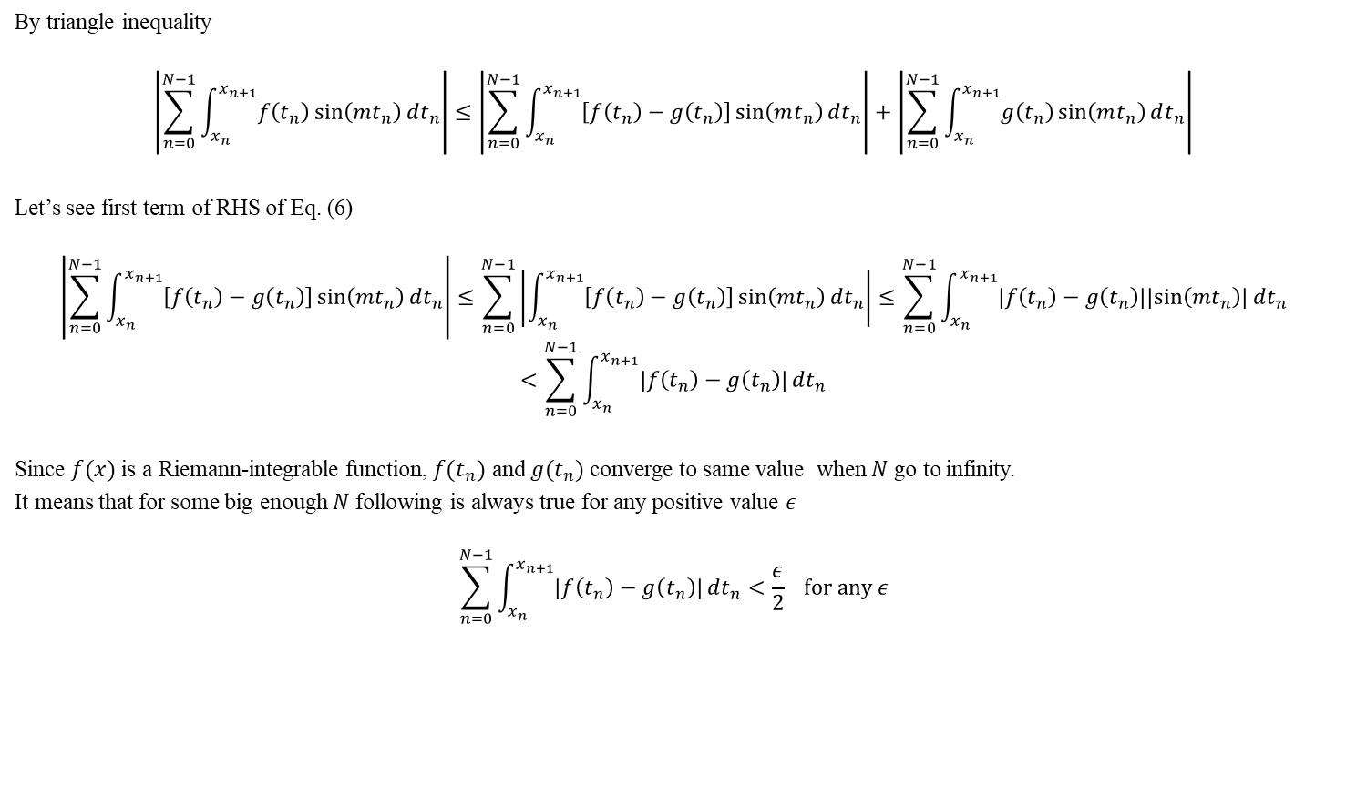
Appendix 2 Riemann-Lebesgue Lemma
By triangle inequality
$$\left|\sum_{n=0}^{N−1}{\int_{x_{n}}^{x_{n+1}}{f\left(t_{n}\right)\sin\left(mt_{n}\right)}dt_{n}}\right|≤\left|\sum_{n=0}^{N−1}{\int_{x_{n}}^{x_{n+1}}{\left[f\left(t_{n}\right)−g\left(t_{n}\right)\right]\sin\left(mt_{n}\right)}dt_{n}}\right|+\left|\sum_{n=0}^{N−1}{\int_{x_{n}}^{x_{n+1}}{g\left(t_{n}\right)\sin\left(mt_{n}\right)}dt_{n}}\right|$$
Let’s see first term of RHS of Eq. (6)
$$\left|\sum_{n=0}^{N−1}{\int_{x_{n}}^{x_{n+1}}{\left[f\left(t_{n}\right)−g\left(t_{n}\right)\right]\sin\left(mt_{n}\right)}dt_{n}}\right|≤\sum_{n=0}^{N−1}{\left|\int_{x_{n}}^{x_{n+1}}{\left[f\left(t_{n}\right)−g\left(t_{n}\right)\right]\sin\left(mt_{n}\right)}dt_{n}\right|}≤\sum_{n=0}^{N−1}{\int_{x_{n}}^{x_{n+1}}{\left|f\left(t_{n}\right)−g\left(t_{n}\right)\right|\left|\sin\left(mt_{n}\right)\right|}dt_{n}}$$
$$<\sum_{n=0}^{N−1}{\int_{x_{n}}^{x_{n+1}}{\left|f\left(t_{n}\right)−g\left(t_{n}\right)\right|}dt_{n}}$$
Since $f(x)$ is a Riemann-integrable function, $f(t_{n})$ and $g(t_{n})$ converge to same value when $N$ go to infinity.
It means that for some big enough $N$ following is always true for any positive value $ε$
$$\sum_{n=0}^{N−1}{\int_{x_{n}}^{x_{n+1}}{\left|f\left(t_{n}\right)−g\left(t_{n}\right)\right|}dt_{n}}<\frac{ε}{2} for any ε$$
(6)

Slide 25
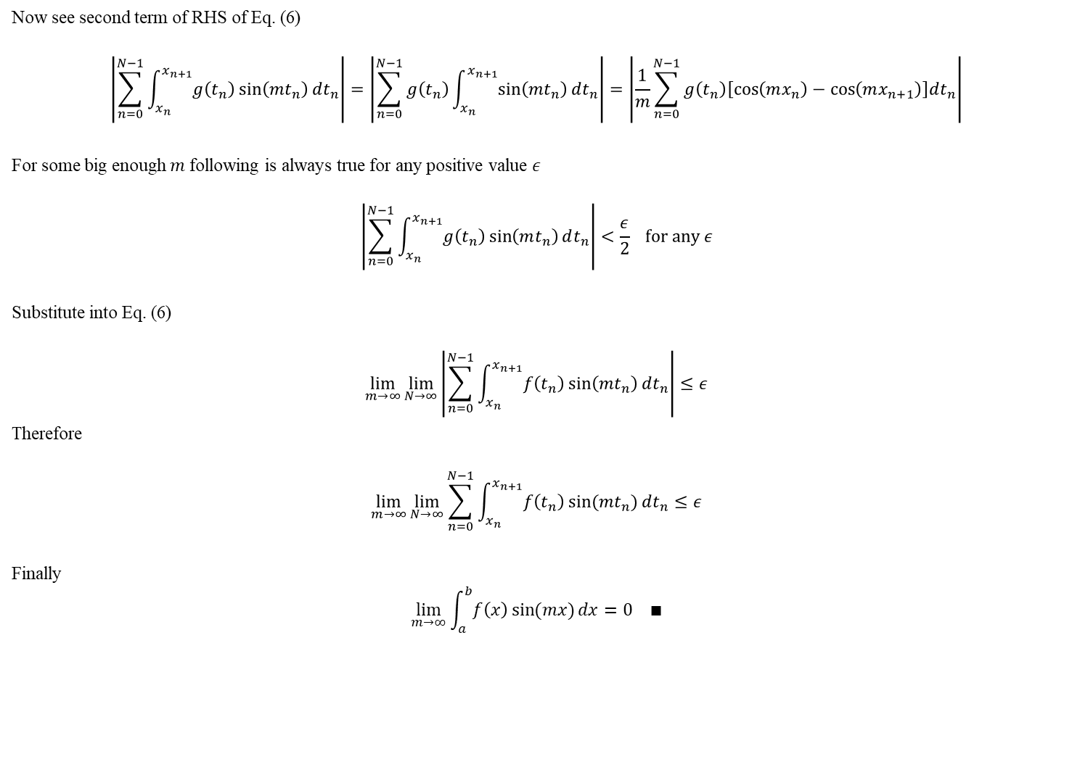
Appendix 2 Riemann-Lebesgue Lemma
Now see second term of RHS of Eq. (6)
$$\left|\sum_{n=0}^{N−1}{\int_{x_{n}}^{x_{n+1}}{g\left(t_{n}\right)\sin\left(mt_{n}\right)}dt_{n}}\right|=\left|\sum_{n=0}^{N−1}{g\left(t_{n}\right)\int_{x_{n}}^{x_{n+1}}{\sin\left(mt_{n}\right)}dt_{n}}\right|=\left|\frac{1}{m}\sum_{n=0}^{N−1}{g\left(t_{n}\right)\left[\cos\left(mx_{n}\right)−\cos\left(mx_{n+1}\right)\right]dt_{n}}\right|$$
For some big enough $m$ following is always true for any positive value $ε$
$$\left|\sum_{n=0}^{N−1}{\int_{x_{n}}^{x_{n+1}}{g\left(t_{n}\right)\sin\left(mt_{n}\right)}dt_{n}}\right|<\frac{ε}{2} for any ε$$
Substitute into Eq. (6)
$$\lim_{m→∞}{\lim_{N→∞}\left|\sum_{n=0}^{N−1}{\int_{x_{n}}^{x_{n+1}}{f\left(t_{n}\right)\sin\left(mt_{n}\right)}dt_{n}}\right|}≤ε$$
Therefore
$$\lim_{m→∞}{\lim_{N→∞}{\sum_{n=0}^{N−1}{\int_{x_{n}}^{x_{n+1}}{f\left(t_{n}\right)\sin{(mt_{n})}}dt_{n}}}}≤ε$$
Finally
$$\lim_{m→∞}{\int_{a}^{b}{f\left(x\right)\sin{(mx)}}dx}=0 ∎$$

